Slide 1

Mapping Global Multistakeholder Institutions (MSIs): Key features & preliminary results
Mary Ann Manahan & Madhuresh Kumar
26 January 2021 | The Global Takeover Webinar

Slide 2
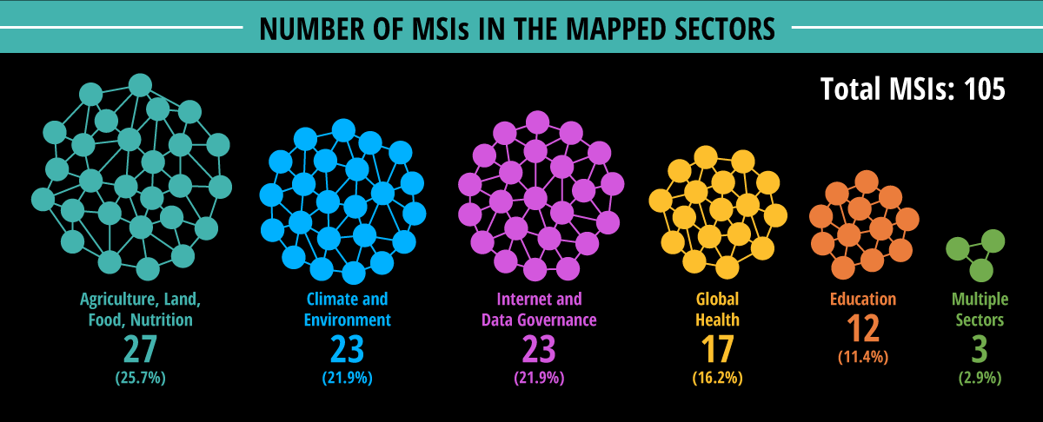
Caveat: Not exhaustive, focused on global MSIs in the 21st century

Slide 3
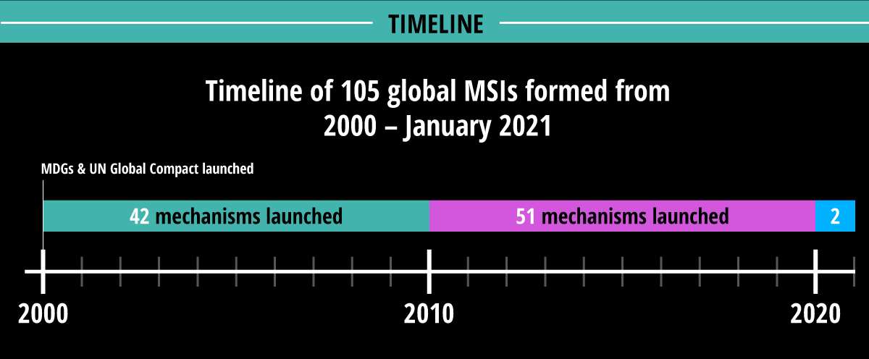
+Timebound MSIs: 10 mechanisms

Slide 4
Who makes the decisions?
Notes:
Out of the 483 distinct/unique 'stakeholders' we identified who are part of the key decision making bodies of the 105 MSIs, 31% are representatives from business/industry. But the top stakeholders that occupy most seats of power in numerous MSIs are the World Bank, WHO, BMGF, USAID, WWF International & Affiliates, & Microsoft

Slide 5
More than one-third of the mapped MSIs combine multiple orientations
New category: Paradigmatic/
Campaign

Slide 6








Accelerating nexus of market-based solutions/ideas: “Nature-positive”-Food Systems-Planetary Boundaries-Planetary Health Diet-Nutrition
Scaling up for Nutrition
Tropical Forests Alliance (host)
UN Food Systems Summit 2021
Natural Capital Coalition/ Capitals Coalition
Wef/wbcsd
EAT Lancet Commission on Sustainable Healthy Systems
Natural Climate Solutions Alliance (convenor)
New Vision for Agriculture (convenor)
Global Commons Alliance
Global Council on Food Security (convenor)
Nature for Climate

Slide 7
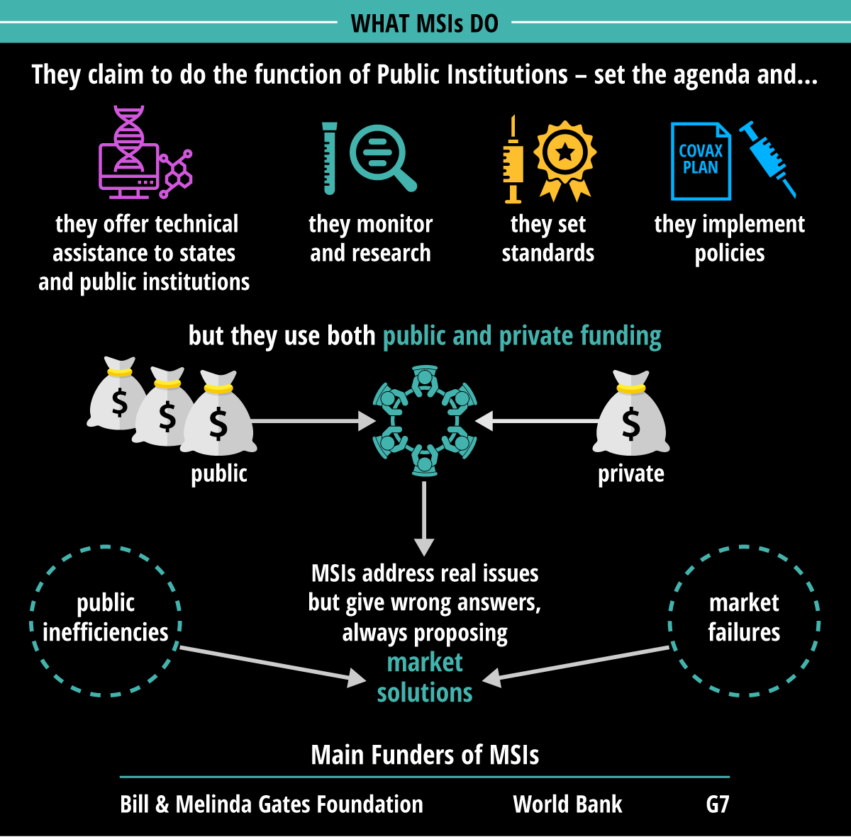

Slide 8
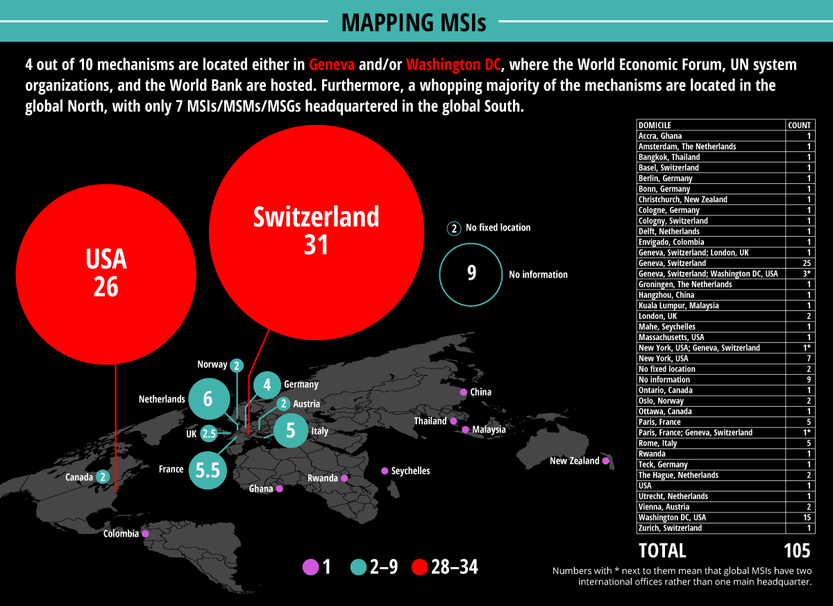

Slide 9
Key strategies & approaches
Convening
Research & Knowledge Production
Partnerships
Multistakeholderism

Slide 10


