Slide 1
Note to activists
The audience for this educational packet are those activists who have focused part of their work on one UN organization and could benefit from understanding the governance context that surrounds that organization. One element of change in the global political dynamic is the introduction of multistakeholderism as a candidate structure for global governance. This mechanism allows TNCs to be direct participants in global governance and acts to co-opt multilateralism and civil society. At the same time there is a an evolving interest in a number of activist community to develop a more equitable and a more effective system of global governance, one that can amongst other things address multidimensional and systemic crises.
In order to make this packet more effective, it was been designed to allow the addition of supplemental slides with context specific to individual sectors. In Part One, for example, there are blank slides available for insertion in the history section and the section on MSism challenges to multilateralism (see slides 3 and 4 below). In Part Two, there are prototype slides available to explain in more detail the history of MSism in a specific sector and another blank slide for describing MS groups specific to a sector (see slides 5 and 6 below) . In Part Three, there are blank prototype slides each of the five sections that can used to identify new options for governing in specific sectors (see slides 7 to 11 below).
The second slide, when saved as an html file, can be uploaded to your website. It has built into it links to pdf downloads of the three presentations.
Harris Gleckman
20 Jan 2020
MSGov@mindspring.com

Slide 2


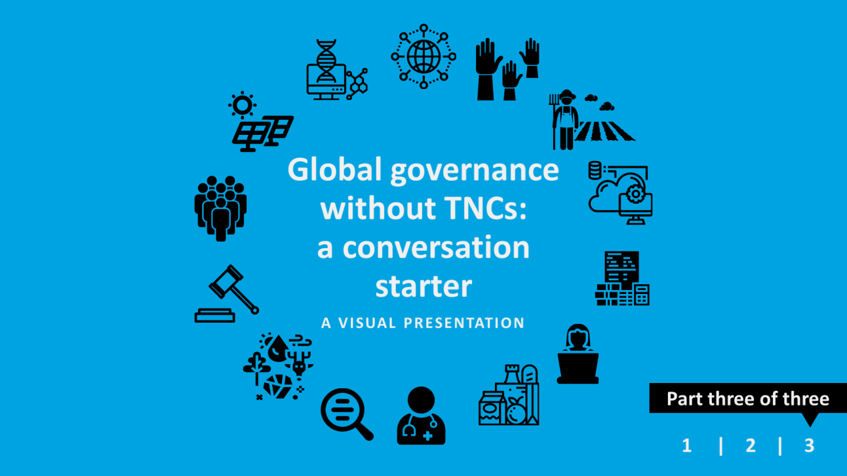
SERIES OF THREE VISUAL PRESENTATIONS
ON GLOBAL GOVERNANCE AND MULTISTAKEHOLDERISM
These three presentations aim to inform social movements and activists about
- how the multilateral system could (and should) control transnational corporations (presentation 1),
- what is wrong with the emerging multistakeholderism (presentation 2)
- how global governance can be framed beyond a globalization dominated by transnational corporations (presentation 3)

Slide 3
Part I : supplemental historical context for a specific sector
Governing Globalization
and TNCs
Summary of history for [health care arena]
Multilateralism
[name of specific UN agency]

Slide 4
Part I : supplemental organizational context on TNCs in a given sector
Major message re Multilateralism, governing TNCs and [heath industry]
Governing Globalization and TNCs in [the health industry]
Multilateralism and [WHO]
Elaboration of major message - I
Elaboration of major message - II

Slide 5
Part 2 : supplemental historical context for a specific sector
A QUICK HISTORY:
TNCs and multistakeholderism in [the global health arena]
End of WWII
Reagan and Thatcher
Rio Conference (1992)
and Global Compact (1998)
Current situation

Slide 6
Part 2 : supplemental information on Msism in a specific sector
MSs active in [the global health arena]
Area of governance | Example | UN or Government that could or should be central

Slide 7
Part 3 : supplemental information on new directions for specific sectors
Governance Actors in [health care]
other candidate ideas, challenges and/or first steps

Slide 8
Part 3 : supplemental information on new directions for specific sectors
Global Governance Institutions for [health care]
other candidate ideas, challenges and/or first steps

Slide 9
Part 3 : supplemental information on new directions for specific sectors
Global Narrative for [health care]
Other Candidates / Challenges/ First Steps

Slide 10
Part 3 : supplemental information on new directions for specific sectors
Governance Tools for [health care]
Other Candidates / Challenges/ First Steps

Slide 11
Part 3 : supplemental information on new directions for specific sectors
Financing Governance of [health care]
Other Candidates / Challenges/ First Steps

